Slide 1

Entity Framework
5 – Model First

Slide 2
Overview
Just some quick comments on the process

Slide 3
Model-First EF
Class library project
Add a data item ado.net entity model
On the designer, define your model
Set the generation model
Saving generates the model

Slide 4
Quick walkthrough in pictures…

Slide 5
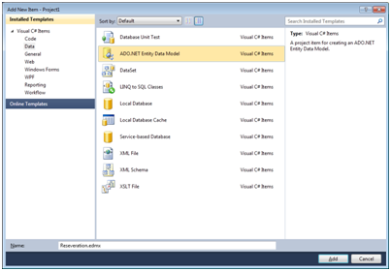
Create the model item

Slide 6
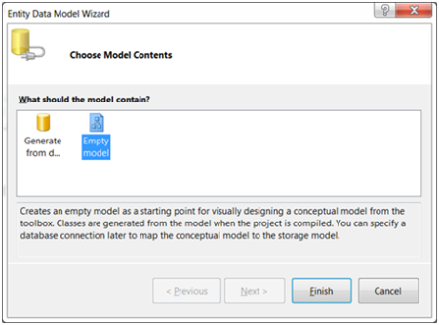
Run the wizard

Slide 7
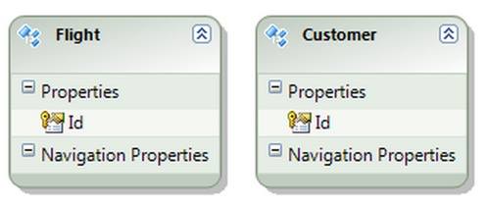
Add Entities

Slide 8
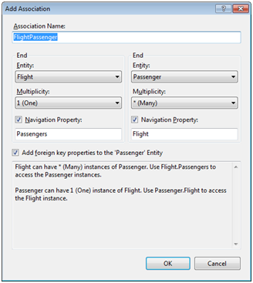
Define associations

Slide 9
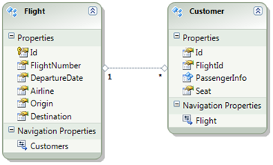
Add the rest of the properties

Slide 10
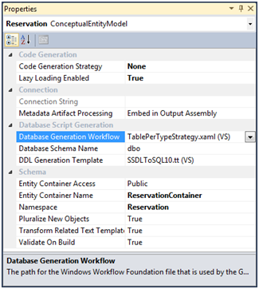
Set the database generation strategy

Slide 11
Generating the database
Validate the model
Generate database
Does not create DB
It creates the SQL to create the db
Run the sql script

Slide 12
When the model changes
Model first…. Everything is dropped
Db changed, update model from db
Essentially you now change to db first

Slide 13
Summary
Model first is neat
One of the most requested features in EF
But if you change and existing model you are now dropping the whole database, and a database change makes you go to database first

